Slide 1
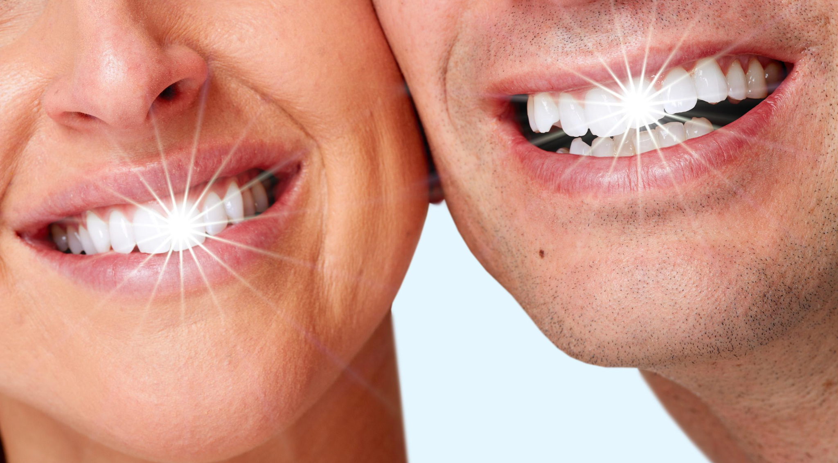
NanoShine
Say goodbye to plaque and caries!
Presented By Team 1.1.A
Alex Weber Pranav Kulkarni Mandi Wang
Pranav Karthikeyan Mihir Kavishwar

Slide 2
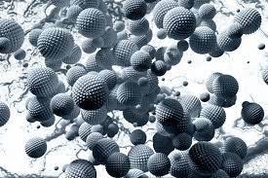
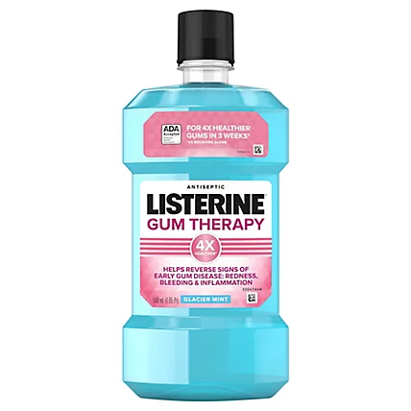
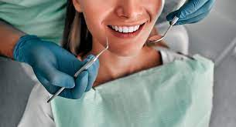
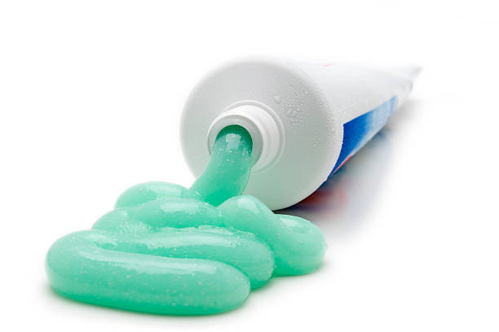
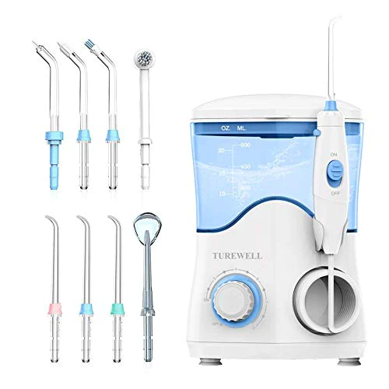
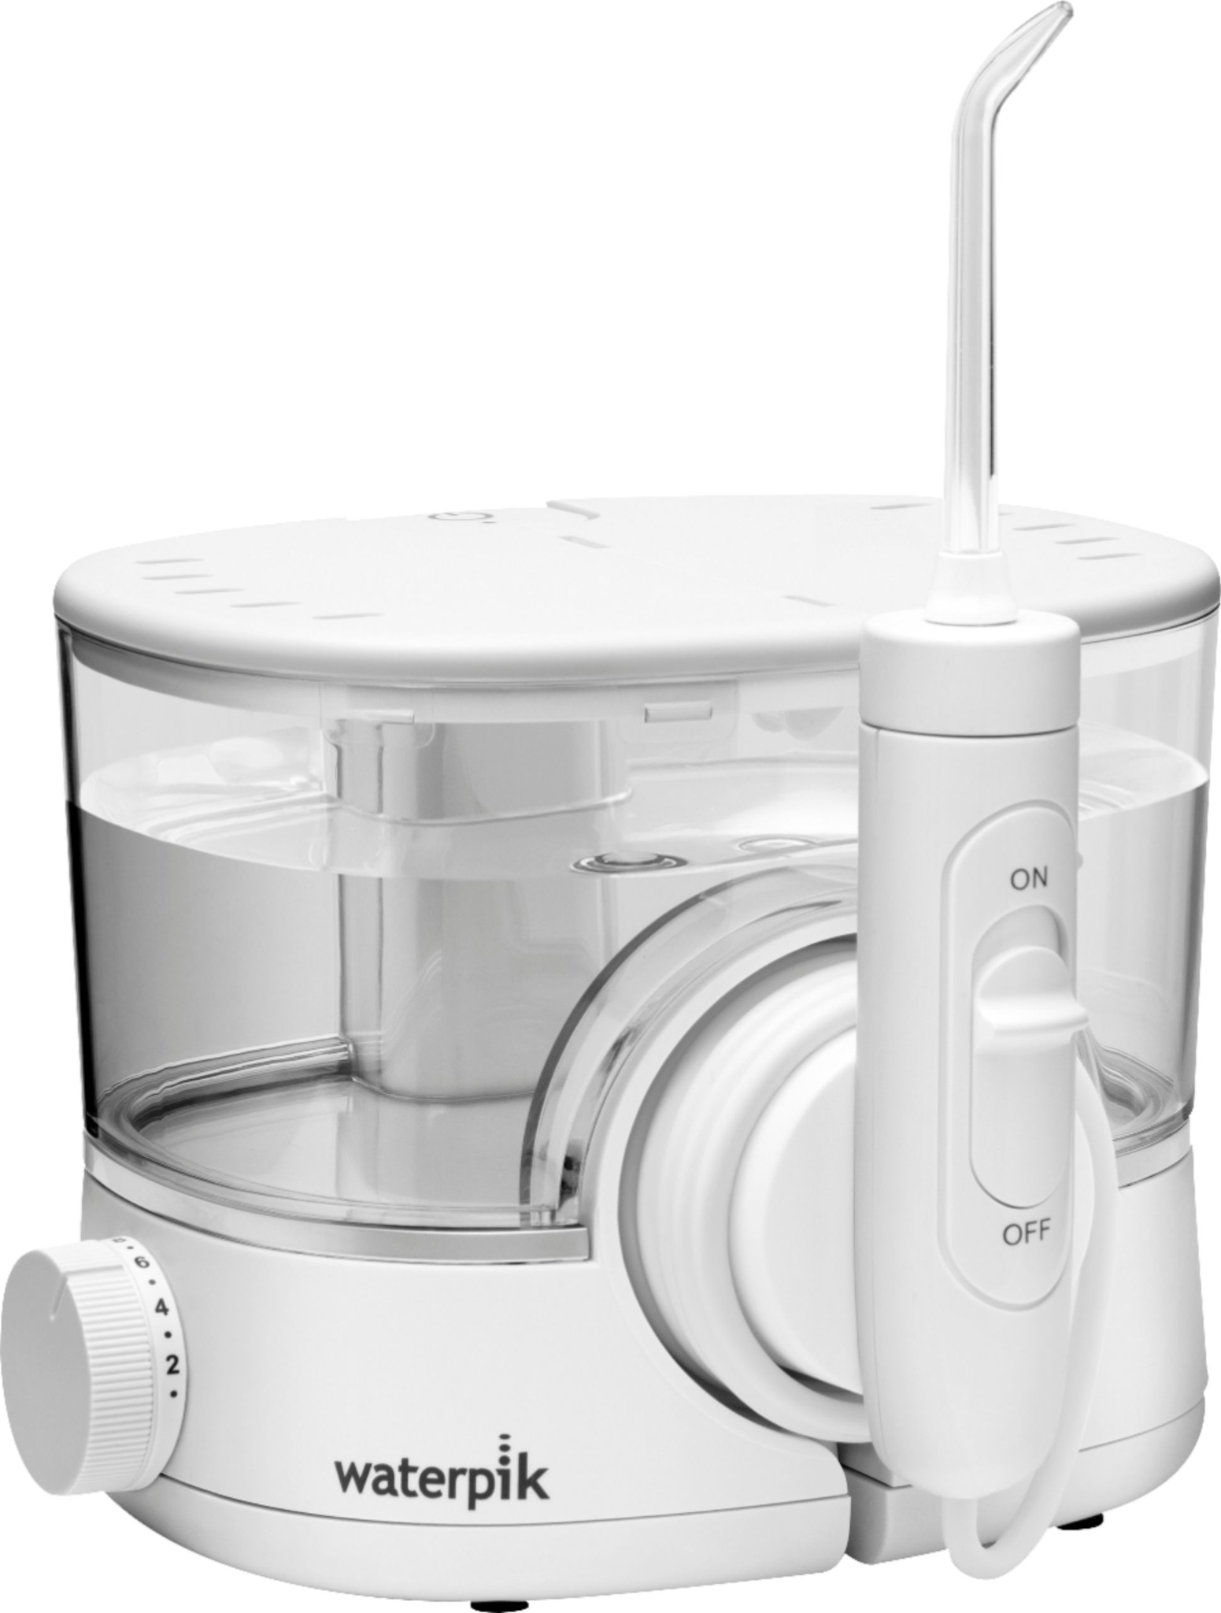
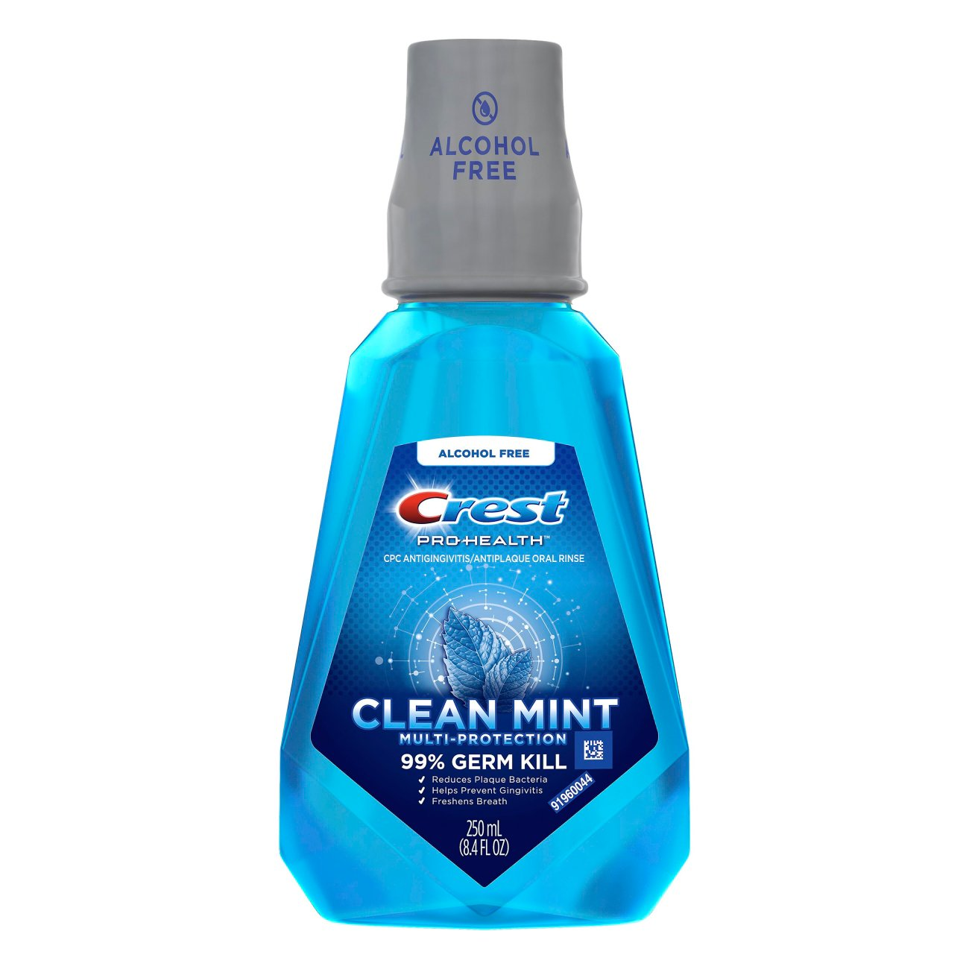
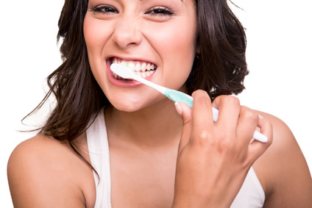
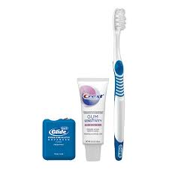
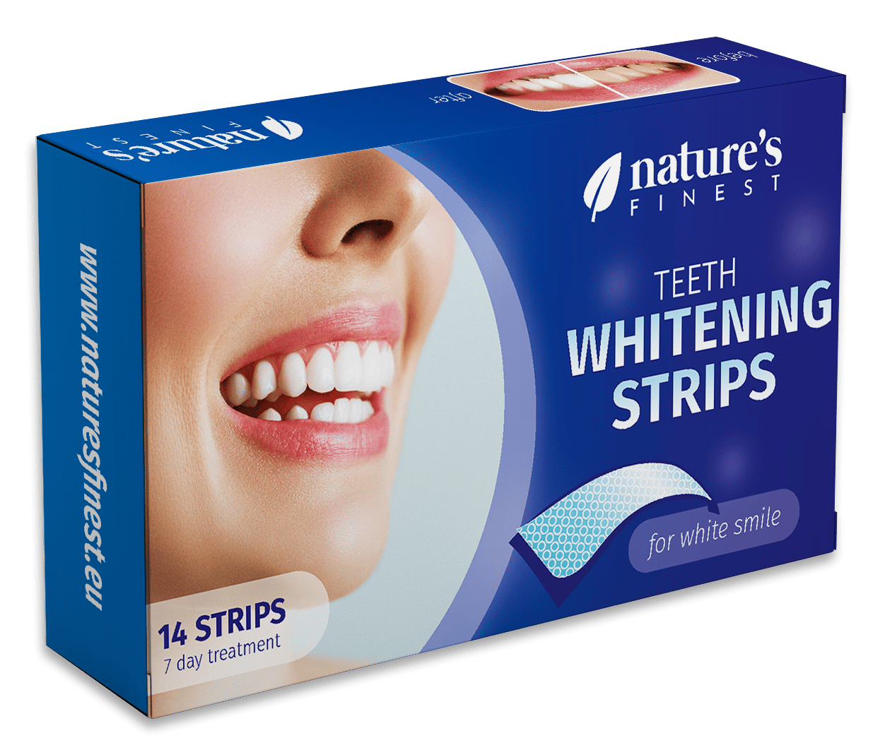
Commercial Application Area
Dental plaque is a biofilm that consists of a wide variety of microorganisms and their by-products.
  Once calcified, their removal is difficult, even with the use of professional dental instruments.
Nanoparticles must be routinely introduced to a biofilm in order to penetrate and disrupt its structural integrity
Our application will deliver the existing nanoparticle technology (developed by AMI) to treat dental biofilms in a way that places no additional burden on the patient.
Current Treatment Options
Applications Considered
Recommended Application

Slide 3
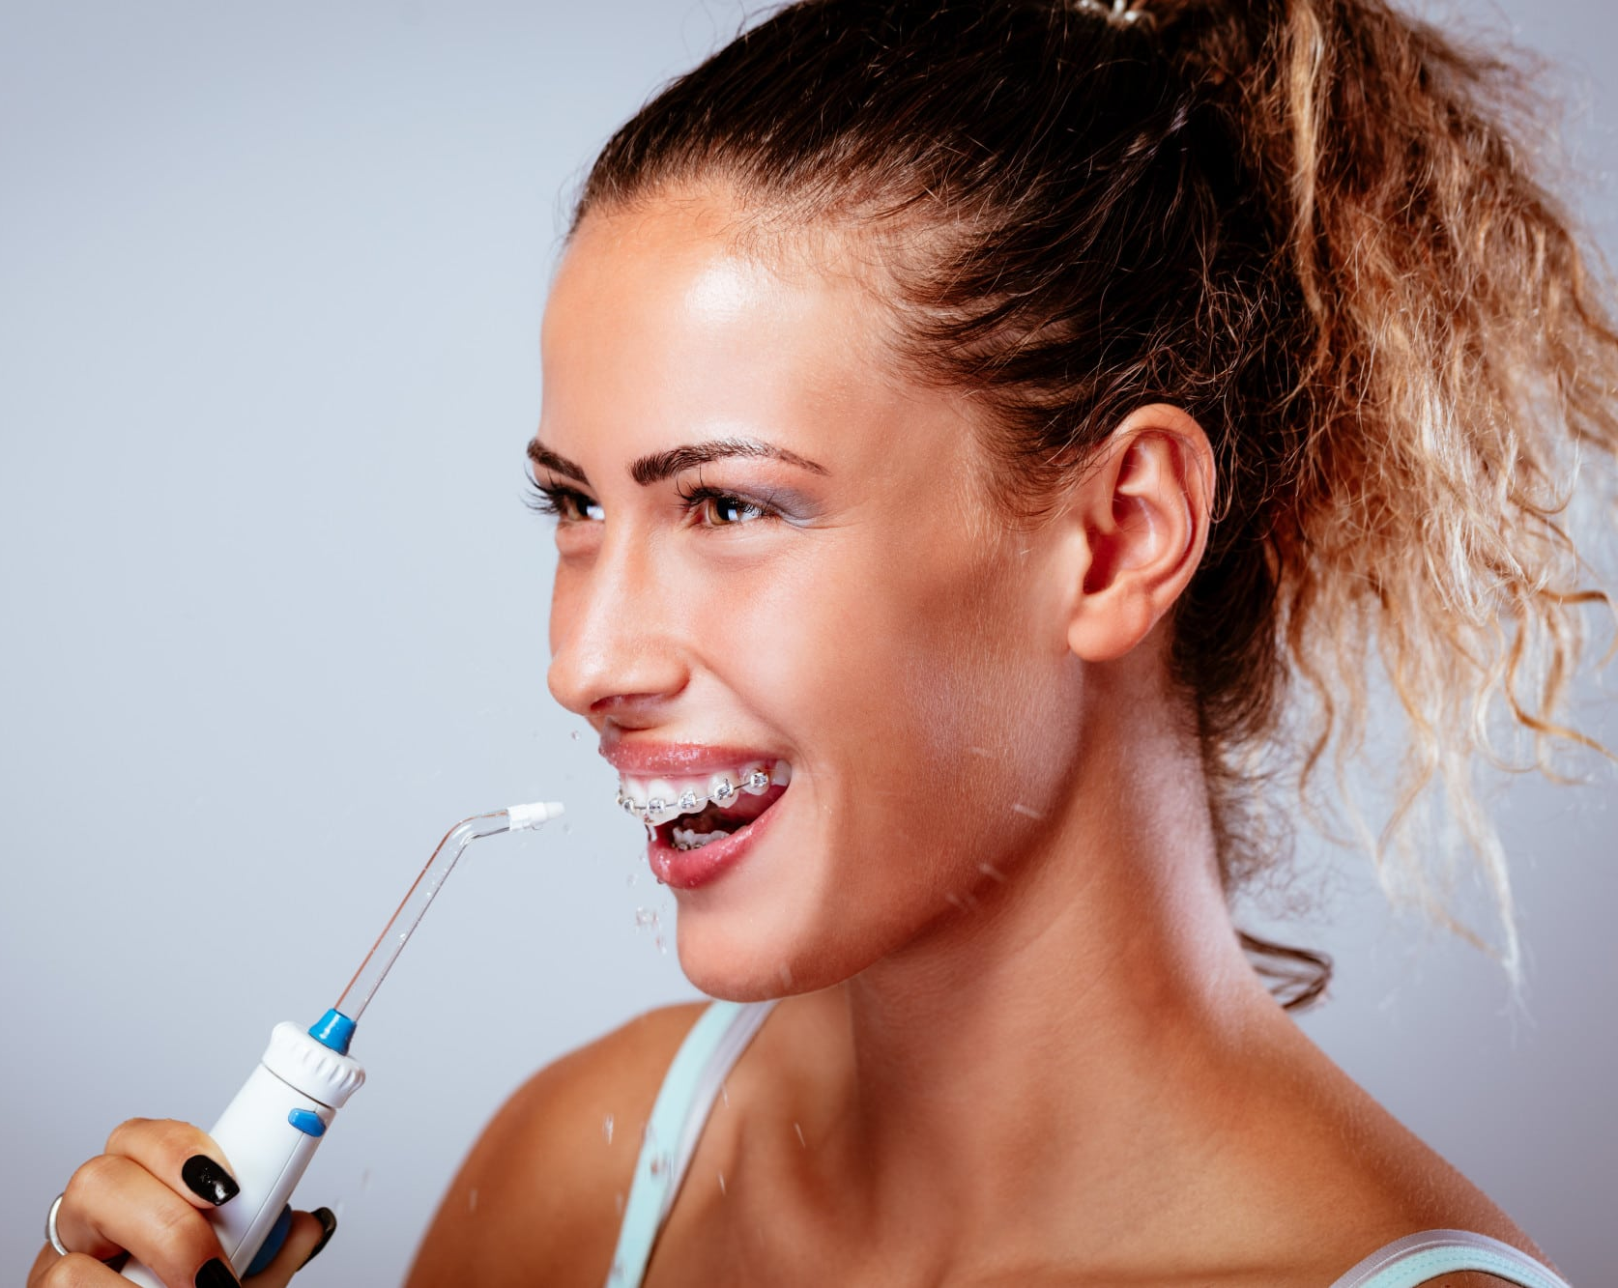




Target Customer
Demographic
Socioeconomic
Geographic
Psychographic
Broad; customers are more clearly defined by psychographic factors
Targeting all genders, ages, and races
Patients who are highly educated (undergraduate and beyond)
Patients with high disposable income
Patients with access to quality dental care
North America holds majority market share in the water flosser market
Fears aging/ tooth decay
Follows habits taught by family of origin, OR
Avoiding patterns learned in family of origin
Fear over facts

Slide 4
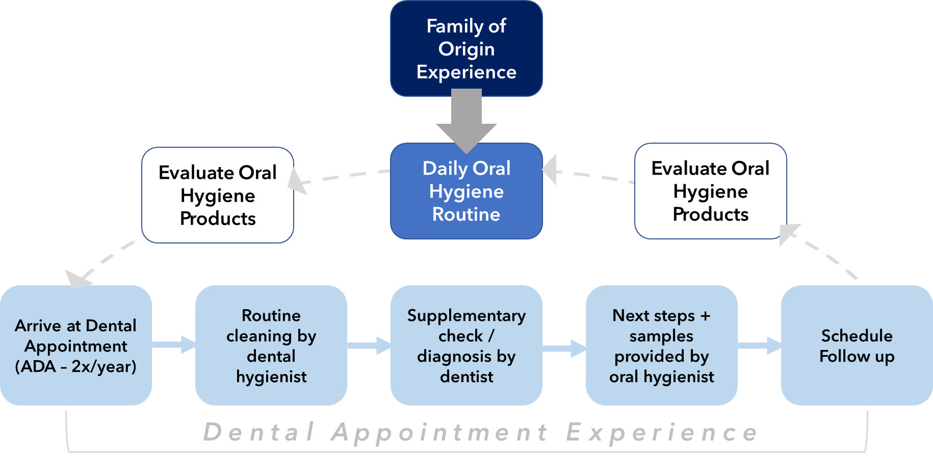
Patient Journey

Slide 5
Interview Findings
1
2
3
4
5
Dentists
42 data points
Asking dentists.
In-person friends
Interviews
In-person interviews of our friends, family, and professors.
In-person random
Asking people in the JFF hallway including students and guards.
Dentists, hygienists, and family of origin educate on dental health
Patients are interested in improving their health & minimizing shame
Patients need proof that solutions actually work before commiting
Patients prioritize appearance of teeth over health of teeth
Patients think that they already have effective oral hygiene

Slide 6
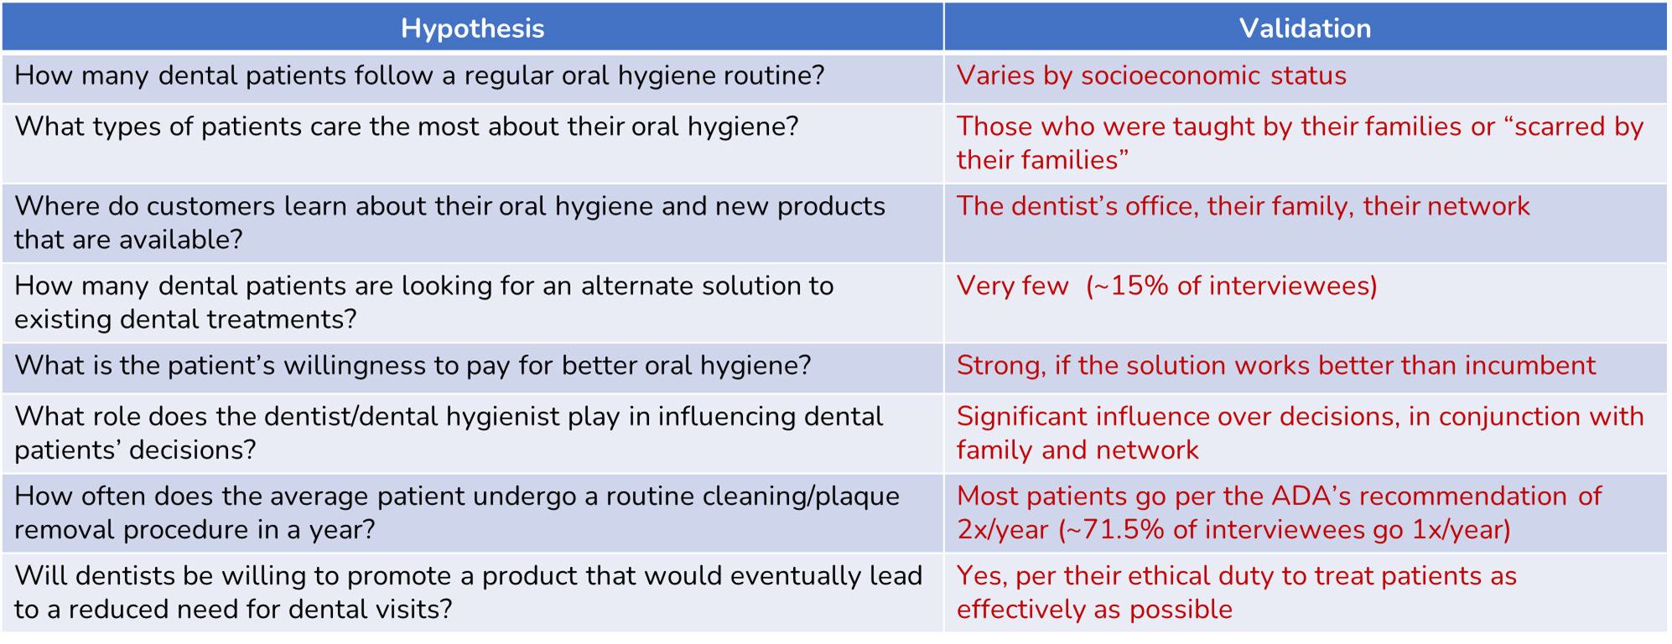



Hypothesis Testing & Market Entry
PRIMARY:
SECONDARY:

Slide 7
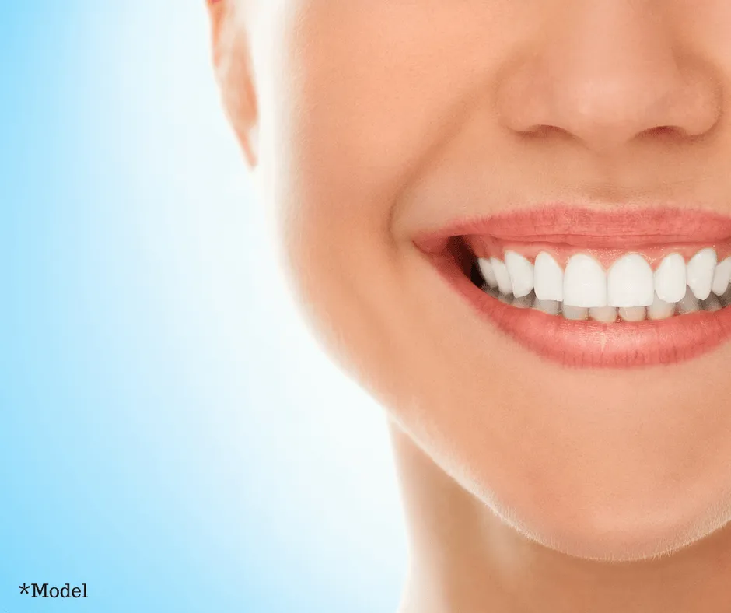
Thank You

